Slide 1
SQL
Database Design

Slide 2
The basics

Slide 3
What is a Database
An organized collection of data stored in electronic format
Allows us to input, manage, organize, and retrieve data quickly
Traditional databases are organized by records(rows) and fields(columns) stored in tables which are stored in database files
Each category of data becomes a column/field. It is a piece of data stored by your table
A table row/record is a single set of columns that describe attributes of a single thing.

Slide 4
The R in RDBMS: Relations & Diagrams
An entity-relationship diagram—otherwise known as an ERD—is a data modeling technique that creates an illustration of an information system's entities and the relationships between those entities.
There are 3 ingredients in a standard entity-relationship diagram:
•Entities, which represent people, places, items, events, or concepts.
•Attributes, which represent properties or descriptive qualities of an entity. These are also known as data elements.
•Relationships, which represent the link between different entities.

Slide 5
Types of ERD’s
Entities, attributes, and relationships can be represented in one of three ways: with a conceptual model, logical model, or physical model. These models increase in complexity as you move from conceptual to logical to physical. It's usually best to start with a conceptual ERD model, so you can understand—at the highest level—the entities in your data and how they relate to each other. As you transform a conceptual ERD to a physical model, you'll learn exactly how to implement modeled information into the database of your choice.
There are two main types of ERD notations: Crow's Foot notation and Chen notation.

Slide 6
Put the R in RDBMS: Relational Databases
Relation = a connection between data
Entity = anything we store data about
Type
Attribute = the data we store
Has a type and a value

Slide 7
SQL

Slide 8
Structured Query Language
SQL is the standard language for relational database systems
All relational managements like MySQL, MS Access, Oracle, etc use SQL as a standard database language
They also use dialects. Oracle, for example, uses PL/SQL

Slide 9
Oracle Database Administration
Schemas - allow you to logically group objects
Schemas are essence of your database
Tablespaces - allocated space where schema objects are created
Users - database accounts

Slide 10
Benefits of SQL
Allows users to
access data in RDBMS
Describe the data
define the data in the DB and manipulate the data
Embed within other languages using SQL modules, libraries, and pre-compilers

Slide 11
DDL: Data Definition Language
Defines Schemas
CREATE
CREATE TABLE tablename (columndefinition) tableparameters
Column definitions are comma-separated lists consisting of any of the following
Column def: columnname datatype constraints
Primary key definition
Constraints
DROP
DROP objecttype objectname
ALTER
ALTER objecttpye objectname parameters

Slide 12
DML: Data Manipulation Language
Think “CRUD” → Create, Read, Update, Delete
INSERT (create)
SELECT (read)
UPDATE
DELETE

Slide 13
DCL: Data Control Language
Used to control access to data stored in a database
GRANT - allows specific users to perform specified tasks
REVOKE - cancels previously granted or denied permissions

Slide 14
DQL: Data Query Language
Used to retrieve the records/data from database
SELECT - extracts data from database

Slide 15
TCL - Transaction control language
COMMIT: to save the changes.
ROLLBACK: to rollback the changes.
SAVEPOINT: creates points within groups of transactions in which to ROLLBACK
SET TRANSACTION: Places a name on a transaction.
Transactional control commands are only used with the DML commands INSERT, UPDATE and DELETE only. They can not be used while creating tables or dropping them because these operations are automatically commited in the database.

Slide 16
Data Types
https://docs.microsoft.com/en-us/sql/t-sql/data-types/data-types-transact-sql?view=sql-server-2017

Slide 17
Constraints and multiplicity

Slide 18
Primary Key
This constraint defines a column or a combination of columns which uniquely identify each row in the table

Slide 19
Foreign key
Identifies any column referencing the primary key in another table
Establishes a relationship between two columns in the same table or between different tables
Maintains referential integrity
Q: can you think of a scenario in which a table would have a FK that references a column in the table itself?

Slide 20
Not Null
Ensures all rows in the table contain a definite value for the column which is specified as not null, so no value is allowed

Slide 21
Unique
Ensures that a column or group of columns in each row have a distinct value (can be null but cannot be duplicated if it does have a value)
What is the difference between a unique constraint and a primary key?
PK = NN + U,
U can be null

Slide 22
Check
Defines a business rule on a column
All rows must satisfy this rule
Can be applied for a single column or group of columns

Slide 23
Multiplicity
Used to be referred to as but not to be confused with cardinality. Changed terms because of semantics
Multiplicity refers to the relationships between tables. There are 1:1 relationships, 1:n, and n:1

Slide 24
1:1 Relationship
A one to one (1:1) relationship is defined as the relationship between two tables where both the tables should be associated with each other based on only one matching row.
This relationship can be created using Primary key-Unique foreign key constraints.
With One-to-One Relationship in SQL, for example, a person can have only one passport.

Slide 25
1:n Relationship
A one to many (1:n) relationship is established by using a primary key in a table and referencing that PK in another table as an FK

Slide 26
N:N Relationship
Relationship between two tables where many rows from one table can have multiple matching rows in another table.
Neither table can support a foreign key to relate the tables, so a junction table (aka join table or associative entity) is created.
A junction table is a database table that contains foreign key references to two or more other database tables. It is the standard way of creating a many-to-many relationship between tables.

Slide 27
Normalization

Slide 28
What is Normalization?
Normalization is the process of organizing columns (attributes) and tables (relations)of a relational database to reduce data redundancy and improve data integrity.
Only store information directly related to the table
Each table should have a unique identifier
There are 7 levels of normal form, but we usually aim to be at at least 3rd Normal Form or 3NF

Slide 29
Atomic Data
When your data is atomic, that means that it’s been broken down into the smallest pieces of data that can’t or shouldn’t be divided.
Think: “What is the one thing my table describes?”, “how will i use the table to get my one thing?”, “Are my columns arranged to make my queries short and to the point?”
A column with atomic data can’t have several values of the same type of data in that column
A table with atomic data can’t have multiple columns with the same type of data.

Slide 30
1NF - first normal form
Each row of data must contain atomic values
Each row of data must have a unique identifier, or primary key
ID | First name | Last Name | Email Address

Slide 31
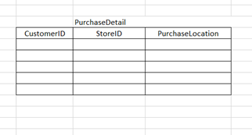
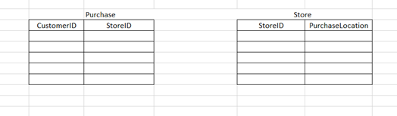
2NF
Any non-key field should be dependent on the entire primary key (no partial dependencies)
Must satisfy 1NF
A table that is in 1st normal form and only has a single column as the primary key (no composite key) is automatically in 2NF

Slide 32
3NF
No non-key should be dependent on another non-key field (no transitive dependencies)
Table should also be in 1NF and 2NF

Slide 33
Joins

Slide 34
What is a join/How’s it different from Select

Slide 35
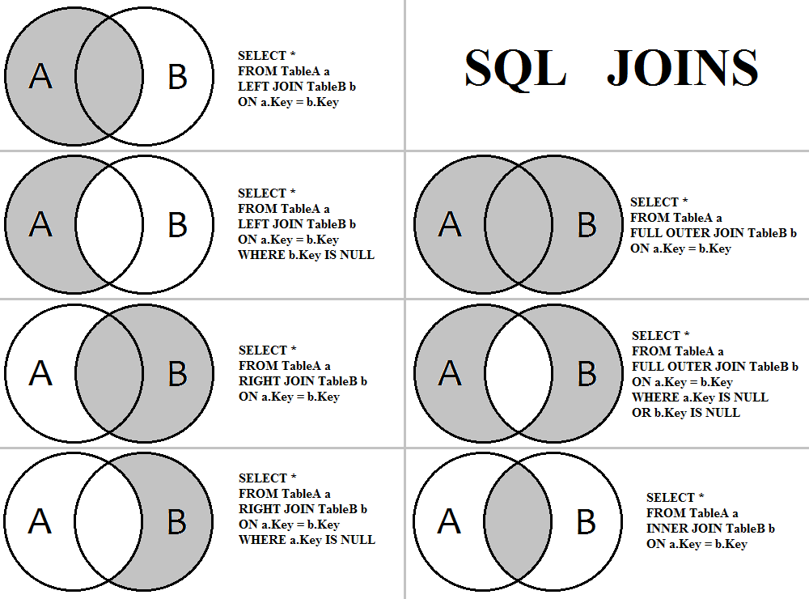

Slide 36
Self Join
Self joins are used when a table references data in itself, and the table is joined to itself as if it were two distinct tables.
One example of this is an employee table with an employee id and manager id (managers are employees), and we want to join employees with their direct managers.
select e.employee as employee, b.employee as boss
from emptable e, emptable b
where e.manager_id = b.empolyee_id;

Slide 37
PL/SQL

Slide 38
Procedural Language extensions to SQL
An extension of SQL used in Oracle
PL/SQL is closely integrated into the SQL language, yet it adds programming constructs that are not native to SQL
Includes:
Sequences
Triggers
Stored procedures
Functions

Slide 39
Stored Procedures
Can return 0-many parameters
Cannot be applied to a column
https://www.techonthenet.com/oracle/procedures.php

Slide 40
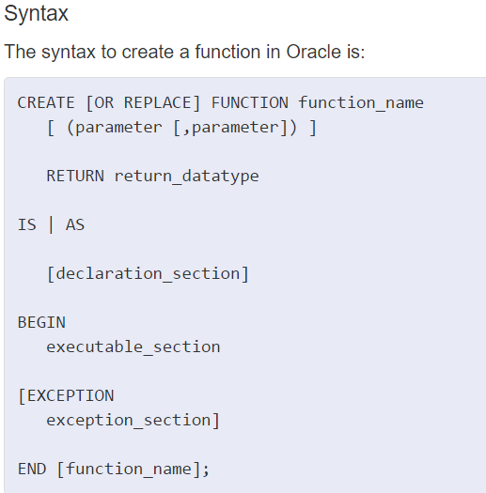
Functions
Must return 1 value
Can be applied to columns
When you create a procedure or function, you may define parameters. There are three types of parameters that can be declared:
IN - The parameter can be referenced by the procedure or function. The value of the parameter can not be overwritten by the procedure or function.
OUT - The parameter can not be referenced by the procedure or function, but the value of the parameter can be overwritten by the procedure or function.
IN OUT - The parameter can be referenced by the procedure or function and the value of the parameter can be overwritten by the procedure or function.

Slide 41
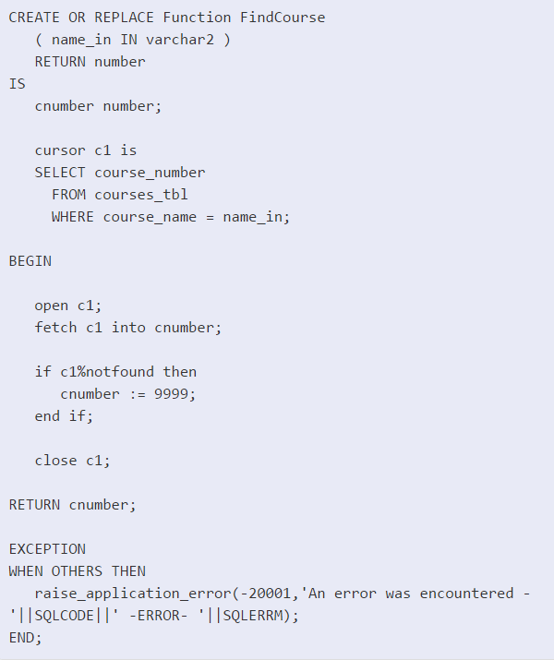
This is a function called FindCourse
It has one parameter called name_in, and it returns a number.
The function will return the course number if it finds a match based on course name
Otherwise, it returns a 99999
To reference the new function, we call a SQL statement as follows
SELECT course_name, FindCourse(course_name) AS course_id
FROM courses
WHERE subject = ‘Mathematics’;

Slide 42
Cursors
https://www.techonthenet.com/orac
le/cursors/index.php

Slide 43
DBMS_OUTPUT
https://www.tutorialspoint.com/plsql/plsql_dbms_output.htm

Slide 44
Transactions

Slide 45
What is a transaction
A transaction is a unit of work that is performed against a database. Transactions are units or sequences of work accomplished in a logical order, whether in a manual fashion by a user or automatically by some sort of a database program.
A transaction is the propagation of one or more changes to the database. For example, if you are creating a record or updating a record or deleting a record from the table, then you are performing transaction on the table. It is important to control transactions to ensure data integrity and to handle database errors.
Practically, you will club many SQL queries into a group and you will execute all of them together as a part of a transaction.

Slide 46
ACID: The properties of a transaction
Atomicity - ensures that all operations within the work unit are completed successfully; otherwise, the transaction is aborted at the point of failure, and previous operations are rolled back to their former state.
Consistency - ensures that the database properly changes states upon a successfully committed transaction
Isolation - enables transactions to operate independently of and transparent to each other.
Durability - ensures that the result or effect of a committed transaction persists in case of a system failure.

Slide 47
Commit Command
The COMMIT command is the transactional command used to save changes invoked by a transaction to the database.
The COMMIT command saves all transactions to the database since the last COMMIT or ROLLBACK command.
Following is the example which would delete records from the table having age = 25 and then COMMIT the changes in the database.
EXAMPLE CODE :
SQL> DELETE FROM CUSTOMERS WHERE AGE = 25; SQL> COMMIT;
Before
+----+----------+-----+-----------+----------+ | ID | NAME | AGE | ADDRESS | SALARY | +----+----------+-----+-----------+----------+ | 1 | Ramesh | 32 | Ahmedabad | 2000.00 | | 2 | Khilan | 25 | Delhi | 1500.00 | | 3 | kaushik | 23 | Kota | 2000.00 | | 4 | Chaitali | 25 | Mumbai | 6500.00 | | 5 | Hardik | 27 | Bhopal | 8500.00 | | 6 | Komal | 22 | MP | 4500.00 | | 7 | Muffy | 24 | Indore | 10000.00 | +----+----------+-----+-----------+----------+
After
+----+----------+-----+-----------+----------+ | ID | NAME | AGE | ADDRESS | SALARY | +----+----------+-----+-----------+----------+ | 1 | Ramesh | 32 | Ahmedabad | 2000.00 | | 3 | kaushik | 23 | Kota | 2000.00 | | 5 | Hardik | 27 | Bhopal | 8500.00 | | 6 | Komal | 22 | MP | 4500.00 | | 7 | Muffy | 24 | Indore | 10000.00 | +----+----------+-----+-----------+----------+

Slide 48
Rollback Command
The ROLLBACK command is the transactional command used to undo transactions that have not already been saved to the database.
The ROLLBACK command can only be used to undo transactions since the last COMMIT or ROLLBACK command was issued.
SQL> DELETE FROM CUSTOMERS WHERE AGE = 25; SQL> ROLLBACK;
Before:
+----+----------+-----+-----------+----------+ | ID | NAME | AGE | ADDRESS | SALARY | +----+----------+-----+-----------+----------+ | 1 | Ramesh | 32 | Ahmedabad | 2000.00 | | 2 | Khilan | 25 | Delhi | 1500.00 | | 3 | kaushik | 23 | Kota | 2000.00 | | 4 | Chaitali | 25 | Mumbai | 6500.00 | | 5 | Hardik | 27 | Bhopal | 8500.00 | | 6 | Komal | 22 | MP | 4500.00 | | 7 | Muffy | 24 | Indore | 10000.00 | +----+----------+-----+-----------+----------+
After:
+----+----------+-----+-----------+----------+ | ID | NAME | AGE | ADDRESS | SALARY | +----+----------+-----+-----------+----------+ | 1 | Ramesh | 32 | Ahmedabad | 2000.00 | | 2 | Khilan | 25 | Delhi | 1500.00 | | 3 | kaushik | 23 | Kota | 2000.00 | | 4 | Chaitali | 25 | Mumbai | 6500.00 | | 5 | Hardik | 27 | Bhopal | 8500.00 | | 6 | Komal | 22 | MP | 4500.00 | | 7 | Muffy | 24 | Indore | 10000.00 | +----+----------+-----+-----------+----------+

Slide 49
Savepoint
A SAVEPOINT is a point in a transaction when you can roll the transaction back to a certain point without rolling back the entire transaction.
The syntax for SAVEPOINT command is as follows:
SAVEPOINT SAVEPOINT_NAME;
This command serves only in the creation of a SAVEPOINT among transactional statements. The ROLLBACK command is used to undo a group of transactions.
The syntax for rolling back to a SAVEPOINT is as follows:
ROLLBACK TO SAVEPOINT_NAME;

Slide 50
Release Savepoint
The RELEASE SAVEPOINT command is used to remove a SAVEPOINT that you have created.
The syntax for RELEASE SAVEPOINT is as follows:
RELEASE SAVEPOINT SAVEPOINT_NAME;
Once a SAVEPOINT has been released, you can no longer use the ROLLBACK command to undo transactions performed since the SAVEPOINT.

Slide 51
Set Transaction
The SET TRANSACTION command can be used to initiate a database transaction. This command is used to specify characteristics for the transaction that follows.
For example, you can specify a transaction to be read only, or read write.
The syntax for SET TRANSACTION is as follows:
SET TRANSACTION [ READ WRITE | READ ONLY ];

Slide 52
Transaction Isolation LEvels
As our applications become more complex, we must account for transactions that may occur at the same time
The transaction isolation level indicates the degree to which two transactions interact with each other over the same data.
The higher the isolation level, the more careful the system is about avoiding conflicts, but the locking overhead can increase while user concurrency can decrease
The transaction problems that can occur are:
lost update
dirty read (aka uncommitted dependency) - transaction reads data that has been written by another transaction that hasn’t been committed yet
unrepeatable read -a transaction rereads data that it has previously read and finds that another committed transaction has modified or deleted the data
phantom read - a transaction re-runs a query returning a set of rows that satisfies a search condition and finds another committed transaction

Slide 53
Isolation levels Cont
Isolation Level | Lost Updates | Dirty Reads | Non-repeatable reads | Phantom Reads
Read Uncommitted | x | - | - | -
Read Committed | x | x | - | -
Repeatable Read | x | x | x | -
Serializable | x | x | x | x

Slide 54
Read committed isolation level is the oracle default
With this, each query can only see committed data before query (not transaction) began

